Slide 1

Government College of Engineering and Research , Avasari
Department of Computer Engineering
DATABASE MANAGEMENT SYSTEM
TE 2019 Course
Prof.K. B. Sadafale
Assistant Professor

Slide 2
Syllabus
Unit I: Introduction to Database Management Systems and ER Model
UNIT II: SQL and PL/SQL
UNIT III: Relational Database Design
UNIT IV: Database Transaction Management
UNIT V: NoSQL Databases
UNIT VI: Advances in Databases

Slide 3
UNIT IV: Database Transaction Management
Introduction to Database Transaction, Transaction states, ACID properties, Concept of Schedule, Serial Schedule.
Serializability: Conflict and View, Cascaded Aborts, Recoverable and Non-recoverable Schedules.
Concurrency Control: Lock-based, Time-stamp based Deadlock handling.
Recovery methods: Shadow-Paging and Log-Based Recovery, Checkpoints.
Log-Based Recovery: Deferred Database Modifications and Immediate Database Modifications.

Slide 4
Unit III
Database Transaction Management

Slide 5
Basic concept of a Transaction.
Transaction
A sequence of many actions which are considered to be one atomic unit of work.
– Read, write, commit, abort
Database transaction
A unit of work performed within a database management system
Governed by four ACID properties:
Atomicity,
Consistency,
Isolation,
Durability
Has a unique starting point, some actions and one end point
A transaction is a unit of work which completes as a unit or fails as a unit.

Slide 6
Transactions
Many enterprises use databases to store information about their state
  e.g., Balances of all depositors at a bank
When an event occurs in the real world that changes the state of the enterprise,
a program is executed to change the database state in a corresponding way
  e.g., Bank balance must be updated when deposit is made
Such a program is called a transaction.

Slide 7
Transaction Concept
A transaction is a unit of program execution that accesses and possibly updates various data items.
E.g. transaction to transfer $50 from account A to account B:
  1. read(A)
  2. A := A – 50
  3. write(A)
  4. read(B)
  5. B := B + 50
  6. write(B)
Two main issues to deal with:
  Failures of various kinds, such as hardware failures and system crashes.
  Concurrent execution of multiple transactions.

Slide 8
Example of Fund Transfer
Transaction to transfer $50 from account A to account B:
  1. read(A)
  2. A := A – 50
  3. write(A)
  4. read(B)
  5. B := B + 50
  6. write(B)
Atomicity requirement
  if the transaction fails after step 3 and before step 6, money will be “lost” leading to an inconsistent database state
    Failure could be due to software or hardware
  the system should ensure that updates of a partially executed transaction are not reflected in the database
Durability requirement
once the user has been notified that the transaction has completed (i.e., the transfer of the $50 has taken place),
The updates to the database by the transaction must persist even if there are software or hardware failures.

Slide 9
Transaction to transfer $50 from account A to account B:
  1. read(A)
  2. A := A – 50
  3. write(A)
  4. read(B)
  5. B := B + 50
  6. write(B)
Consistency requirement
in above example:
  the sum of A and B is unchanged by the execution of the transaction
In general, consistency requirements include
    Explicitly specified integrity constraints such as primary keys and foreign keys
    Implicit integrity constraints
      e.g. sum of balances of all accounts, minus sum of loan amounts must equal value of cash-in-hand
  A transaction must see a consistent database.
  During transaction execution the database may be temporarily inconsistent.
  When the transaction completes successfully the database must be consistent
    Erroneous transaction logic can lead to inconsistency

Slide 10
Isolation requirement
if between steps 3 and 6, another transaction T2 is allowed to access the partially updated database, it will see an inconsistent database
(the sum A + B will be less than it should be).
T1 T2
  1. read(A)
  2. A := A – 50
  3. write(A)
  read(A), read(B), print(A+B)
  4. read(B)
  5. B := B + 50
  6. write(B
Isolation can be ensured trivially by running transactions serially
  that is, one after the other.
However, executing multiple transactions concurrently has significant benefits.

Slide 11
The ACID Properties
Atomicity:
All actions in the transaction happen, or none happen.
A real-world event either happens or does not happen
  Student either registers or does not register
Similarly, the system must ensure that either the corresponding transaction runs to completion or, if not, it has no effect at all
Consistency:
If each transaction is consistent, and the DB starts consistent, it ends up consistent.
Isolation:
Execution of one transaction is isolated from that of other transactions.
Durability:
If a transaction commits, its effects persist.
The system must ensure that once a transaction commits, its effect on the database state is not lost in spite of subsequent failures

Slide 12
Concurrent execution of user programs is essential for good DBMS performance.
A user’s program may carry out many operations on the data retrieved from the database.
but the DBMS is only concerned about what data is read/written from/to the database.
A transaction is the DBMS’s abstract view of a user program: a sequence of reads and writes.

Slide 13
Transaction State
Active
The initial state; the transaction stays in this state while it is executing
Partially committed
After the final statement has been executed.
Failed
After the discovery that normal execution can no longer proceed.
Aborted
After the transaction has been rolled back and the database restored to its state prior to the start of the transaction.
Two options after it has been aborted:
  restart the transaction
    can be done only if no internal logical error
  kill the transaction
Committed
After successful completion.

Slide 14


Transaction State (Cont.)

Slide 15
Concept of Schedule
In the fields of databases and transaction processing (transaction management), a schedule of a system is an abstract model to describe execution of transactions running in the system.
Often it is a list of operations (actions) ordered by time, performed by a set of transactions that are executed together in the system.
Schedule – a sequences of instructions that specify the chronological order in which instructions of concurrent transactions are executed
  a schedule for a set of transactions must consist of all instructions of those transactions
  must preserve the order in which the instructions appear in each individual transaction.
A transaction that successfully completes its execution will have a commit instructions as the last statement
  by default transaction assumed to execute commit instruction as its last step
A transaction that fails to successfully complete its execution will have an abort instruction as the last statement .

Slide 16
Concurrent execution
Transaction processing systems usually allows multiple transactions to run concurrently.
Concurrent execution of multiple transaction cause several complication with consistency of data.
There are two good reasons for allowing concurrency
1) Improved throughput and resource utilization.
2) Reduce waiting time.
1) Improved throughput and resource utilization.
“Throughput is number of transaction executed in a given amount of time.”
A transaction consist of many steps.
Some involves I/O activity other involves CPU activity.
The CPU and disks in Computer system can operate in parallels.

Slide 17
The parallelism of the CPU and the I/O system can therefore be exploited to run multiple transaction in parallel.
If one transaction is reading or writing data on disk another can running in CPU.
All of this increase throughput of the system correspondingly , the processor and disk utilization also increase.
Thus the processor and disk spend less time idle.

Slide 18
2) Reduce waiting time.
There may be a mix of transaction running on the system, some short and some long.
If transaction run serially , a short transaction may have to wait for a preceding long transaction to complete.
Which can lead to unpredictable delay in running a transaction.
If the transaction are operating on different parts of the database , it is better to let them run concurrently, sharing the CPU cycles and disk access among them.
Concurrent execution reduces the unpredictable delays in running transaction.
It also reduces the average response time- the average time for a transaction to be completed after it has been submitted .
The motivation for using concurrent execution in database is essentially the same as the motivation for using multiprogramming in an operating system.

Slide 19

Example
Let T1 and T2 are two transaction
Let T₁ transfer $50 from A to B, and T₂ transfer 10% of the balance from A to B.
  Suppose the current value of A and B are $ 1000 & $ 2000 respectively.
  Suppose the two transactions are executed in the order T1 followed by T2.
A serial schedule in which T₁ is followed by T₂ :
Schedule 1

Slide 20
The final values of account A and account B after execution of schedule1 are $855 and $2145 respectively. Thus the sum A+B is preserved.
A=950
Write(950)
Read(2000)
B=2050
write(2050)
Read(950)
temp=95
A=950-95=855
Write(855)
Read(2050)
B=2050 + 95
Write(2145)

Slide 21

The final values of account A and B after the execution of schedule1 are $855 and $2145 respectively.
Thus the sum A+B is preserved.
The execution sequence which represent the chronological order in which instructions are executed in the system , are called schedule.
  A serial schedule where T₂ is followed by T₁
Schedule 2

Slide 22

The given two transaction can be executed concurrently.
Let T₁ and T₂ be the transactions defined previously.
One possible concurrent schedule is given below.
The following schedule is not a serial schedule, but it is equivalent to Schedule 1.
A=1000
A=950
Write(950)
Read(950)
Temp=95
A=950-95=855
Write(855)
Read(2000)
Schedule 3
B=2050
Write(2050)
Read(2050)
B=2050+95=2145
Write(2145)

Slide 23

After the execution of above schedule 3 , we arrive at the same state as the one which the transactions are executed serially in the order T1 followed by T2.
The sum A+B is preserved.
Not all concurrent execution result in a correct state.
The following concurrent schedule 4 does not preserve the value of (A + B ).
A=1000
A=950
Read(950)
Temp=100
Schedule 4
A=950-100=850
Write(850)
Read(2000)
Write(850)
Read(2000)
B=2050
Write(2050)
B=2000+100=2100
Write(2100)

Slide 24
The concurrent schedule 4 does not preserve the value of (A + B ).
After the execution of schedule 4 , we arrive at a state where the final values of account A and B are $850 and $2100 respectively.
This final state in an inconsistent state.
We can ensure consistency of the database under concurrent execution by making sure that any schedule that executed has the same effect as that of serial schedule.

Slide 25
Serializability
A transaction schedule is serializable if its outcome (e.g., the resulting database state) is equal to the outcome of its transactions executed serially,
i.e., sequentially without overlapping in time.
Serializability is the major correctness criterion for concurrent transactions' executions
Basic Assumption – Each transaction preserves database consistency.
Thus serial execution of a set of transactions preserves database consistency.
A (possibly concurrent) schedule is serializable if it is equivalent to a serial schedule.
We must first understand which schedule will ensure consistency and which schedule is not.
Transactions are a programs, it is computationally difficult to determine exactly what operations a transaction performs and how operation of various transaction interact.
We consider only two operations: read and write.

Slide 26
Different forms of schedule equivalence give rise to the notions of:
  1. conflict serializability
  2. view serializability
Simplified view of transactions
  We ignore operations other than read and write instructions
  We assume that transactions may perform arbitrary computations on data in local buffers in between reads and writes.
  Our simplified schedules consist of only read and write instructions.

Slide 27
Conflict Serializability
Consider the schedule S in which there are two consecutive instructions Ii and Ij of transaction Ti and Tj respectively ( i not equals to j)
If Ii and IJ refers to different data items then we can swap Ii and IJ
Without affecting the results of any instructions in the schedule.
If Ii and Ij refers to the same data item Q then the order of two steps may matters.
Since we are dealing with only read and write instruction.

Slide 28
There are four cases that we need to consider.
1) Ii =Read(Q) , Ij = Read(Q).
The order of Ii and Ij does not matter.
The same values of Q read by Ti and Tj.
2) Ii=Read(Q) , Ij=Write(Q)
If Ii comes before Ij , then Ti does not read the value of Q that is written by Tj in instruction Ij.
If Ij comes before Ii then Ti read the value of Q that is written by Tj.
The order of Ii and Ij matters.
3) Ii=Write(Q) , Ij = Read(Q)
The order of Ii and Ij matters for reason similar to those of the previous case.
4) Ii = Write(Q) , Ij=Write(Q)
The order of these instructions does not affect either Ti or Tj because both operation are write.

Slide 29
We say that Ii and Ij conflict
if there are operations by different transactions on the same data items.
At least one of these instructions is write operation.
Instructions l_{i} and l_{j} of transactions T_{i} and T_{j} respectively, conflict if and only if there exists some item Q accessed by both l_{i} and l_{j},
and at least one of these instructions write Q.
1. l_{i} = read(Q), l_{j} = read(Q). l_{i} and l_{j} don’t conflict.
2. l_{i} = read(Q), l_{j} = write(Q). They conflict.
3. l_{i} = write(Q), l_{j} = read(Q). They conflict
4. l_{i} = write(Q), l_{j} = write(Q). They conflict

Slide 30

Consider the following schedule for the concept of conflict instructions.
Write(A) of T1 conflicts with Read(A) instruction of T2
The write(A) of T2 does not conflict with Read(B) of T1
Reasons:-Two instruction access different data items A & B.

Slide 31
View Serializability
Let S and S´ be two schedules with the same set of transactions.
S and S´ are view equivalent if the following three conditions are met:
  For each data item Q, if transaction T_{i} reads the initial value of Q in schedule S, then transaction T_{i} must, in schedule S´, also read the initial value of Q.
  For each data item Q if transaction T_{i} executes read(Q) in schedule S, and that value was produced by transaction T_{j} (if any), then transaction T_{i} must in schedule S´ also read the value of Q that was produced by transaction T_{j} .
  For each data item Q, the transaction (if any) that performs the final write(Q) operation in schedule S must perform the final write(Q) operation in schedule S´.
As can be seen, view equivalence is also based purely on reads and writes alone.

Slide 32
Condition 1 and 2 ensure that each transaction reads the same values in both schedules and therefore performs the same computation.
Condition 3 ,coupled with condition 1 and 2 , ensure that both schedules result in the same final system state.
Consider the following schedules
Schedule 1
Schedule 2
Schedule 3

Slide 33
In above schedule , schedule 1 is not view equivalence to schedule 2.
Since in schedule 1 , the value of account A read by transaction T2 was produced by T1.
Where as this case does not hold in schedule 2.
Schedule 1
Schedule 2

Slide 34
However schedule 1 is view equivalence to schedule 3 ,
Because the value of account A and B read by transaction T2 were produced by T1 in both schedules.
We say that a schedule S is view serializable if it is view equivalent to serial schedule.
Schedule 1
Schedule 3

Slide 35
Testing for serializability
How to determine given a particular schedule S , whether the schedule is serializable.
A simple and efficient method for determining conflict serializability of a schedule is precedence graph or directed graph.
This graph consist of a pair G =(V , E) where V is set of vertices and E is a set of edges.
The set of vertices consist of all the transactions participating in the schedule.
The set of edges consists of all edges Ti Tj for which one of three conditions holds.
1. Ti executes write(Q) before Tj executes read(Q).
2. Ti executes read(Q) before Tj executes write(Q).
3. Ti executes write(Q) before Tj executes write(Q).

Slide 36
If an edge Ti Tj exists in the precedence graph , then in any serial schedule S’ equivalent to S , Ti must appear before Tj
Consider schedule 1 as follows
Precedence graph for this is as shown
T1
T2

Slide 37
Consider schedule 2 as follows
Precedence graph for this is as shown
T2
T1

Slide 38
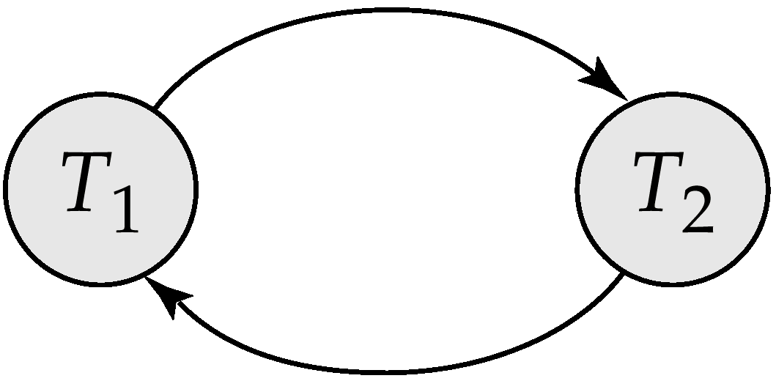
Consider schedule 4 as follows
Precedence graph for this is as shown

Slide 39
It contain edge T1 T2 because T1 executes read(A) before T2 executes write(A).
It also contains the edge T2 T1 because T2 executes read(B) before T1 execute write(B).
If the precedence graph for S has a cycle , then schedule is not conflict serializable.
If the graph contains no cycles, then the schedule S is conflict serializable.
There exists no efficient algorithm to test for view serializability.
If the sufficient conditions are satisfied , the schedule is view serializable.

Slide 40
Recoverability
Need to address the effect of transaction failures during concurrent execution.
If transaction Ti fails , we need to undo the effect of this transaction to ensure the atomicity property of transaction.
It is necessary also to ensure that any transaction Tj that is dependent on Ti (means Tj has read data written by Ti) is also aborted.
To achieve this we need to place restrictions on the type of schedules permitted in the system.

Slide 41
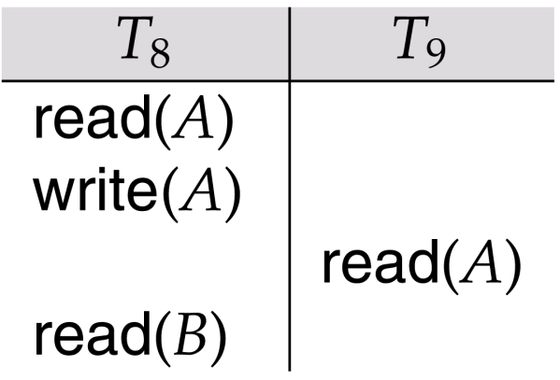
Recoverable and Non-recoverable Schedules
Recoverable schedule — if a transaction T_{j} reads a data items previously written by a transaction T_{i} , the commit operation of T_{i} appears before the commit operation of T_{j}.
Consider the following schedule
T9 is a transaction that performs only one instruction : read(A).
Suppose that T9 commit immediately after executing read(A).
T9 commit before T8 does.
Suppose T8 fails before its commits.
Since T9 has read the value of data item A written by T8 , we must abort T9 to ensure transaction atomicity.

Slide 42
However ,T9 has already committed and can not aborted .
Thus we have a situation where it is impossible to recover correctly from the failure of T8.
The commit happening immediately after the read (A) instruction , is an example of a Nonrecoverable schedule .
Most data base require that all schedule be recoverable.

Slide 43
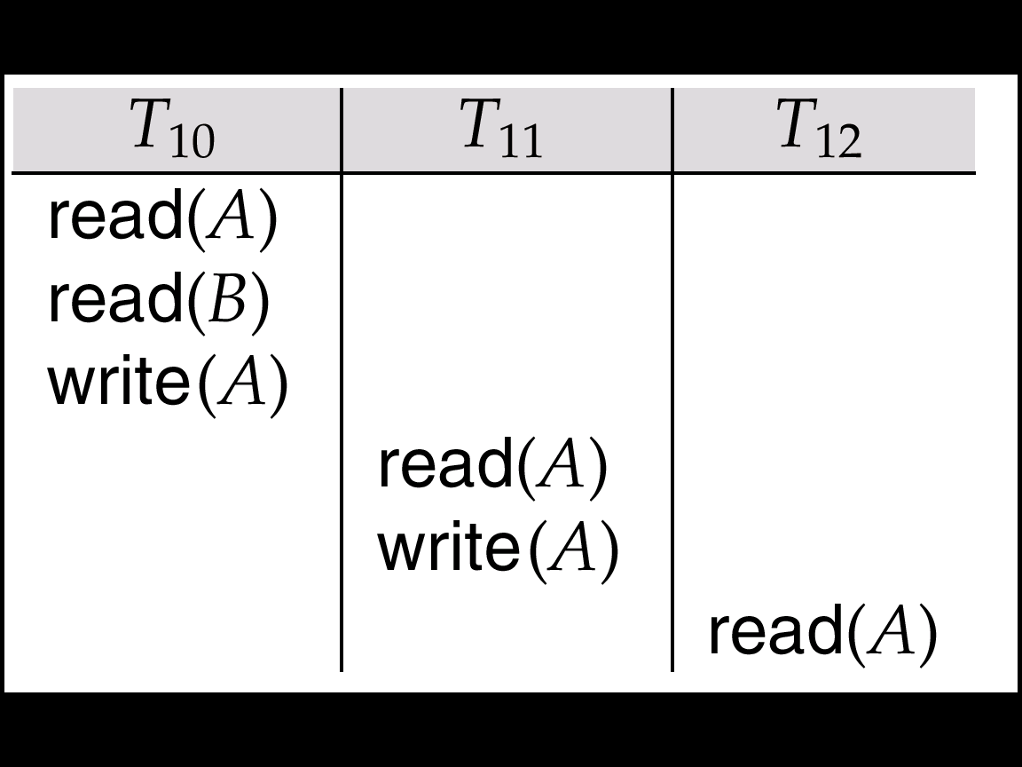
Cascadeless schedules
To recover schedule correctly from the failure of transaction Ti , we may have to roll back several transaction.
Consider the following schedule
Transaction T10 writes a value of A that is read by transaction T11.
Transaction T11 writes a value of A that is read by transaction T12.
Suppose that at this point T10 fails.
T10 must be rolled back .

Slide 44
Since T11 is dependent on T10,T11 must be rolled back ,
Since T12 is dependent on T11, T12 must be rolled back.
This phenomenon in which a single transaction failure leads to a series of transaction rollbacks, is called cascading rollback.
Cascading rollback is undesirable , since it leads to the undoing of a significant amount of work.
It is desirable to restrict a schedules to those where cascading rollbacks cannot occur.
Such schedule are called cascadless schedules.
Cascadless schedules:- one where , for each pair of transactions Ti and Tj such that Tj reads a data item previously written by Ti , the commit operation of Ti appears before the read operation of Tj.

Slide 45
Concurrency Control
Concurrence control is a mechanism to ensure that the system must control the interaction among the concurrent transaction.
Lock-Based Protocols
One way to ensure serializability is to require that while one transaction is accessing a data item, no other transaction can modify that data item.
The most common method used to implement this requirement is holding a lock on that item.

Slide 46
locks
A lock is a mechanism to control concurrent access to a data item
Data items can be locked in two modes :
1. exclusive (X) mode. Data item can be both read as well as written.
X-lock is requested using lock-X instruction.
2. shared (S) mode. Data item can only be read.
S-lock is requested using lock-S instruction.
Lock requests are made to concurrency-control manager. Transaction can proceed only after request is granted.

Slide 47
Example of a transaction performing locking:
T₂: lock-S(A);
read (A);
unlock(A);
lock-S(B);
read (B);
unlock(B);
display(A+B)
Locking as above is not sufficient to guarantee serializability — if A and B get updated in-between the read of A and B, the displayed sum would be wrong.
A locking protocol is a set of rules followed by all transactions while requesting and releasing locks. Locking protocols restrict the set of possible schedules.

Slide 48

Pitfalls of Lock-Based Protocols
Consider the partial schedule
Neither T₃ nor T₄ can make progress — executing lock-S(B) causes T₄ to wait for T₃ to release its lock on B, while executing lock-X(A) causes T₃ to wait for T₄ to release its lock on A.
Such a situation is called a deadlock.
  To handle a deadlock one of T₃ or T₄ must be rolled back
  and its locks released.

Slide 49
The potential for deadlock exists in most locking protocols.
Starvation is also possible if concurrency control manager is badly designed.
For example:
  A transaction may be waiting for an X-lock on an item, while a sequence of other transactions request and are granted an S-lock on the same item.
  The same transaction is repeatedly rolled back due to deadlocks.
Concurrency control manager can be designed to prevent starvation.

Slide 50
The Two-Phase Locking Protocol
This is a protocol which ensures conflict-serializable schedules.
By the 2PL protocols are applied and removed in two phases.
Phase 1: Growing Phase
  Locks are acquired and no locks are released.
Phase 2: Shrinking Phase
  Locks are released and no locks are acquired.
The protocol assures serializability.
It can be proved that the transactions can be serialized in the order of their lock points (i.e. the point where a transaction acquired its final lock).

Slide 51
The Two-Phase Locking Protocol (Cont.)
Two-phase locking does not ensure freedom from deadlocks
Cascading roll-back is possible under two-phase locking. To avoid this, follow a modified protocol called strict two-phase locking.
Here a transaction must hold all its exclusive locks till it commits/aborts.
Rigorous two-phase locking is even stricter: here all locks are held till commit/abort.
In this protocol transactions can be serialized in the order in which they commit.
There can be conflict serializable schedules that cannot be obtained if two-phase locking is used.

Slide 52
Deadlock Handling
System is deadlocked if there is a set of transactions such that every transaction in the set is waiting for another transaction in the set.
E.g : there exists a set of waiting transaction { T0,T1,T2…Tn}
Such that T0 is waiting for a data item that T1 holds , and T1 is waiting for a data item that T2 hold and ….., and Tn-1 is waiting for a data item that Tn holds , and Tn is waiting for a data item that T0 holds.
Non of the transactions can make progress in such situation.

Slide 53
There are two principal methods for dealing with deadlock problem.
1.A deadlock prevention protocol to ensure that the system will never enter a deadlock state.
2.A deadlock detection and deadlock recovery scheme, we can allow the system to enter a deadlock state , and then try to recover by using deadlock detection and deadlock recovery scheme.

Slide 54
deadlock prevention
There are two approaches to deadlock prevention
1.Ensures that no cyclic waits can occur by ordering the request for locks.
2.Transaction rollback instead of waiting for a lock.
The first approach require that each transaction locks all its data items before it begins execution.
Another approach for preventing deadlocks is to impose an ordering of all data items, and to require that a transaction lock data items only in a sequence consistent with the ordering

Slide 55
More Deadlock Prevention Strategies
Following schemes use transaction timestamps for the sake of deadlock prevention alone.
wait-die scheme — non-preemptive
  Older transaction may wait for younger one to release data item.
  Younger transactions never wait for older ones; they are rolled back instead.
  a transaction may die several times before acquiring needed data item
wound-wait scheme — preemptive
  Older transaction wounds (forces rollback) of younger transaction instead of waiting for it.
  Younger transactions may wait for older ones.
  may be fewer rollbacks than wait-die scheme.

Slide 56
deadlock detection and deadlock recovery
Deadlock detection
Deadlocks can be described as a wait-for graph, which consists of a pair G = (V,E),
  V is a set of vertices (all the transactions in the system)
  E is a set of edges; each element is an ordered pair T_{i} →T_{j}.
If T_{i} → T_{j} is in E, then there is a directed edge from T_{i} to T_{j}, implying that T_{i} is waiting for T_{j} to release a data item.
When T_{i} requests a data item currently being held by T_{j}, then the edge T_{i} T_{j} is inserted in the wait-for graph. This edge is removed only when T_{j} is no longer holding a data item needed by T_{i}.
The system is in a deadlock state if and only if the wait-for graph has a cycle.
Must invoke a deadlock-detection algorithm periodically to look for cycles.

Slide 57


Deadlock Detection (Cont.)
Wait-for graph without a cycle
Wait-for graph with a cycle

Slide 58
Deadlock Recovery
When detection algorithm determines that a deadlock exists, the system must recover from the deadlock.
The most common solution is to rollback one or more transactions to break the deadlock.
Three action need to be taken
1.Selection of victim
  Some transaction will have to rolled back (made a victim) to break deadlock.
  Select that transaction as victim that will incur minimum cost.
2.Rollback
Once we have decided that a particular transaction must be rollback .
We must determine how far this transaction should be rolled back.

Slide 59
Total rollback -Abort the transaction and then restart it.
Partial rollback- Rollback the transaction only as far as necessary to break the deadlock.
3.Starvation
In a system where the selection of victims is based primarily on cost factor.
It may happen that the some transaction always picked as a victim.
This transaction never completes its designated task , thus there is starvation.
We must ensure that a transaction can be picked as a victim only a (small) finite number of times.
The most common solution is to include the number of rollbacks in the cost factor.

Slide 60
Timestamp-Based Protocols
With each transaction Ti in the system , data base system associate a unique fixed timestamp.
Denoted by TS(Ti).
If an old transaction T_{i} has time-stamp TS(T_{i}), a new transaction T_{j} is assigned time-stamp TS(T_{j}) then TS(T_{i}) <TS(T_{j}).
The protocol manages concurrent execution such that the time-stamps determine the serializability order.
If TS(T_{i}) <TS(T_{j}) , then the system must ensure that the produced schedule is equivalent to a serial schedule in which transaction Ti appears before transaction Tj.

Slide 61
In order to assure such behavior, the protocol maintains for each data Q two timestamp values:
  W-timestamp(Q) is the largest time-stamp of any transaction that executed write(Q) successfully.
  R-timestamp(Q) is the largest time-stamp of any transaction that executed read(Q) successfully.

Slide 62
The timestamp-ordering protocol
The timestamp-ordering protocol ensuring that any conflicting read and write operations are executed in timestamp order.
This protocol operate as follows:
Suppose a transaction T_{i} issues a read(Q)
1. If TS(T_{i}) ≤ W-timestamp(Q), then T_{i} needs to read a value of Q that was already overwritten. Hence, the read operation is rejected, and T_{i} is rolled back.
2. If TS(T_{i})≥ W-timestamp(Q), then the read operation is
executed, and R-timestamp(Q) is set to the maximum of R- timestamp(Q) and TS(T_{i}).

Slide 63
Suppose that transaction T_{i} issues write(Q).
If TS(T_{i}) < R-timestamp(Q), then the value of Q that T_{i} is producing was needed previously, and the system assumed that value would never be produced.
Hence, the write operation is rejected, and T_{i} is rolled back.
Otherwise, the write operation is executed, and W-timestamp(Q) is set to TS(T_{i}).

Slide 64
Recovery methods
There are various types of failure that may occur in a system.
Each of which needs to be deal with different manner.
The simplest failure – does not result the loss of information in the system.
The difficult failure – deals with loss of information in the system.

Slide 65
Types of failure
Transaction failure :
  Logical errors: transaction cannot complete due to some internal error condition
  System errors: the database system must terminate an active transaction due to an error condition (e.g., deadlock)
System crash: a power failure or other hardware or software failure causes the system to crash.
Disk failure: a head crash or similar disk failure destroys all or part of disk storage

Slide 66
Recovery Algorithms
Recovery algorithms are techniques to ensure database consistency and transaction atomicity and durability despite failures.
Recovery algorithms have two parts
  Actions taken during normal transaction processing to ensure enough information exists to recover from failures.
  Actions taken after a failure to recover the database contents to a state that ensures atomicity, consistency and durability.

Slide 67
Recovery and Atomicity
Modifying the database without ensuring that the transaction will commit may leave the database in an inconsistent state.
Consider transaction T_{i} that transfers $50 from account A to account B; goal is either to perform all database modifications made by T_{i} or none at all.
Several output operations may be required for T_{i} (to output A and B). A failure may occur after one of these modifications have been made but before all of them are made.

Slide 68
We study two approaches:
  Log-Based Recovery, and
  Shadow-Paging
We assume (initially) that transactions run serially, that is, one after the other.

Slide 69
Log-Based Recovery
A log is kept on stable storage.
  The log is a sequence of log records, and maintains a record of update activities on the database.
When transaction T_{i} starts, it registers itself by writing a
<T_{i} start>log record
Before T_{i} executes write(X), a log record <T_{i}, X, V₁, V₂> is written, where V₁ is the value of X before the write, and V₂ is the value to be written to X.
  Log record notes that T_{i} has performed a write on data item X_{j} X_{j} had value V₁ before the write, and will have value V₂ after the write.
When T_{i} finishes it last statement, the log record <T_{i} commit> is written.
We assume for now that log records are written directly to stable storage (that is, they are not buffered)
Two approaches using logs
  Deferred database modification
  Immediate database modification

Slide 70
Deferred Database Modification
The deferred database modification scheme records all modifications to the log, but defers(postpone) all the writes to after partial commit.
Assume that transactions execute serially
Transaction starts by writing <T_{i} start> record to log.
A write(X) operation results in a log record <T_{i}, X, V> being written, where V is the new value for X
  Note: old value is not needed for this scheme
The write is not performed on X at this time, but is deferred.
When T_{i} partially commits, <T_{i} commit> is written to the log
Finally, the log records are read and used to actually execute the previously deferred writes.

Slide 71
Deferred Database Modification (Cont.)
During recovery after a crash, a transaction needs to be redone if and only if both <T_{i} start> and<T_{i} commit> are there in the log.
Redoing a transaction T_{i} ( redoT_{i}) sets the value of all data items updated by the transaction to the new values.
Crashes can occur while
  the transaction is executing the original updates, or
  while recovery action is being taken
example transactions T₀ and T₁ (T₀ executes before T₁):
T₀: read (A) T₁ : read (C)
A: - A - 50 C:-C- 100
Write (A) write (C)
read (B)
B:- B + 50
write (B)

Slide 72

Deferred Database Modification (Cont.)
Below we show the log as it appears at three instances of time.
If log on stable storage at time of crash is as in case:
(a) No redo actions need to be taken
(b) redo(T₀) must be performed since <T₀ commit> is present
(c) redo(T₀) must be performed followed by redo(T₁) since
<T₀ commit> and <T_{i} commit> are present

Slide 73
Immediate Database Modification
The immediate database modification scheme allows database updates of an uncommitted transaction to be made as the writes are issued
  since undoing may be needed, update logs must have both old value and new value
Update log record must be written before database item is written
  We assume that the log record is output directly to stable storage
  Can be extended to postpone log record output, so long as prior to execution of an output(B) operation for a data block B, all log records corresponding to items B must be flushed to stable storage
Output of updated blocks can take place at any time before or after transaction commit
Order in which blocks are output can be different from the order in which they are written.

Slide 74
Immediate Database Modification Example
Log Write Output
<T₀ start>
<T₀, A, 1000, 950>
T_{o}, B, 2000, 2050
A = 950
B = 2050
<T₀ commit>
<T₁ start>
<T₁, C, 700, 600>
C = 600
B_{B}, B_{C}
<T₁ commit>
B_{A}
Note: B_{X} denotes block containing X.
x₁

Slide 75
Immediate Database Modification (Cont.)
Recovery procedure has two operations instead of one:
  undo(T_{i}) restores the value of all data items updated by T_{i} to their old values, going backwards from the last log record for T_{i}
  redo(T_{i}) sets the value of all data items updated by T_{i} to the new values, going forward from the first log record for T_{i}
Both operations must be idempotent
  That is, even if the operation is executed multiple times the effect is the same as if it is executed once
    Needed since operations may get re-executed during recovery
When recovering after failure:
  Transaction T_{i} needs to be undone if the log contains the record
  <T_{i} start>, but does not contain the record <T_{i} commit>.
  Transaction T_{i} needs to be redone if the log contains both the record <T_{i} start> and the record <T_{i} commit>.
Undo operations are performed first, then redo operations.

Slide 76

Immediate DB Modification Recovery Example
Below we show the log as it appears at three instances of time.
Recovery actions in each case above are:
(a) undo (T₀): B is restored to 2000 and A to 1000.
(b) undo (T₁) and redo (T₀): C is restored to 700, and then A and B are
set to 950 and 2050 respectively.
(c) redo (T₀) and redo (T₁): A and B are set to 950 and 2050
respectively. Then C is set to 600

Slide 77
Shadow Paging
Shadow paging is an alternative to log-based recovery; this scheme is useful if transactions execute serially
The database is partitioned into some number of fixed length blocks, which are referred to as pages.
The pages are stored in any random order on the disk .
Therefore there is a page table which points to the blocks on the disk.
The key Idea behind the shadow paging technique is to maintain two page tables during the lifetime of a transaction –the current page table, and the shadow page table
Store the shadow page table in nonvolatile storage, such that state of the database prior to transaction execution may be recovered.
  Shadow page table is never modified during execution.
  Current page table may changed when a transaction performs a write operation.
To start with, both the page tables are identical. Only current page table is used for data item accesses during execution of the transaction.
Whenever any page is about to be written for the first time
  A copy of this page is made onto an unused page.
  The current page table is then made to point to the copy
  The update is performed on the copy

Slide 78

Sample Page Table

Slide 79

Example of Shadow Paging
Shadow and current page tables after write to page 4

Slide 80
Shadow Paging (Cont.)
To commit a transaction :
1. Flush all modified pages in main memory to disk
2. Output current page table to disk
3. Make the current page table the new shadow page table, as follows:
  keep a pointer to the shadow page table at a fixed (known) location on disk.
  to make the current page table the new shadow page table, simply update the pointer to point to current page table on disk
Once pointer to shadow page table has been written, transaction is committed.
No recovery is needed after a crash — new transactions can start right away, using the shadow page table.
Pages not pointed to from current/shadow page table should be freed (garbage collected).

Slide 81
Checkpoints
Problems in recovery procedure as discussed earlier :
  searching the entire log is time-consuming
  we might unnecessarily redo transactions which have already
  output their updates to the database.
Streamline recovery procedure by periodically performing checkpointing
  Output all log records currently residing in main memory onto stable storage.
  Output all modified buffer blocks to the disk.
  Write a log record < checkpoint> onto stable storage.

Slide 82
Checkpoints (Cont.)
During recovery we need to consider only the most recent transaction T_{i} that started before the checkpoint, and transactions that started after T_{i}.
  Scan backwards from end of log to find the most recent <checkpoint> record
  Continue scanning backwards till a record <T_{i} start> is found.
  Need only consider the part of log following above start record. Earlier part of log can be ignored during recovery, and can be erased whenever desired.
  For all transactions (starting from T_{i} or later) with no <T_{i} commit>, execute undo(T_{i}). (Done only in case of immediate modification.)
  Scanning forward in the log, for all transactions starting from T_{i} or later with a <T_{i} commit>, execute redo(T_{i}).

Slide 83
Example of Checkpoints
T₁ can be ignored (updates already output to disk due to checkpoint)
T₂ and T₃ redone.
T₄ undone
T_{c}
T_{f}
T₁
T₂
T₃
T₄
checkpoint
system failure

Slide 84
End of Unit IV

